Slide 1

First Approach on Automated Psychomorphological Analysis Implementation via Computer Vision
Valentín Ramírez Sadovski
Master in Foundations in Data Science
Supervisor: Dr. Sergio Escalera, UB-CVC Barcelona, 2 of July of 2017

Slide 2
Introduction
Morphopsychology: establishes correlations between the shapes of the face and the psychological proﬁle of a person.
Very antique origins: Hippocrates, Galen, Pythagoras, Aristotle , later Leonardo da Vinci , Lavater and Darwin and in the 19-th century Dr. Claude Sigaud.
Louis Corman , the founder: Quinze leçons de morphopsychologie, 1937.

Slide 3
Background
Affective computing: deep learning and computer vision applied to psychology.
No record of any work in Morphosycology

Slide 4
Motivation
Morphosycology seems very suitable for this task, it maps facial features to personality traits.
Morphopsychology can be a good source of information, especially for people who are professionally engaged in human relations and direct contact with the public.
High complexity of the discipline makes it desirable to be automatized for easier aplication and learning.

Slide 5
Areas of application of Morphopsychology
Business sector : selection of personnel, best communication strategies for a partner or client,etc.
Psychology: preliminary notions of the personality of the patient/pre-diagnosis for more fluid therapeutic process.
Education: optimization of learning strategies for each student.

Slide 6
The Data
50 images of frontal faces of famous people with the correspondent punctuations for the selected morphosychological cryteria.
Ground trouth obtained from Sicograf-Institut Mellado.
Value scale: defined and used for the first time.

Slide 7
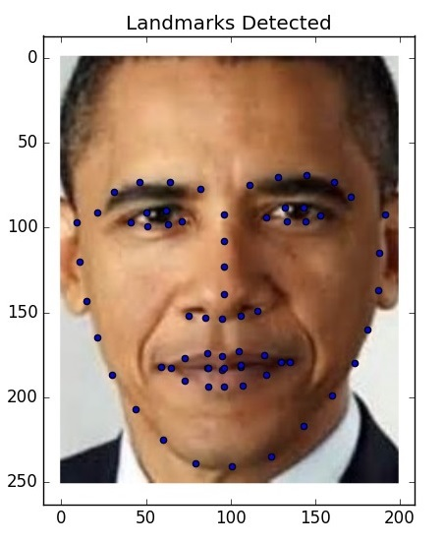
Selected cryteria and methodology applied
Images preprocessed manually with an image editor.
Main method used: facial landmark localization with Supervised Descent Method wth pretrained weights on 300-w dataset.

Slide 8
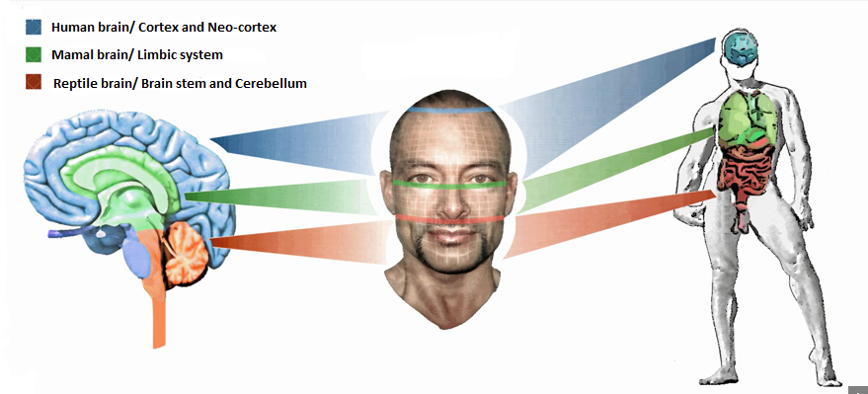
Three zones analysis cryteria:
Rational/Emotional/Instinctive predominance

Slide 9
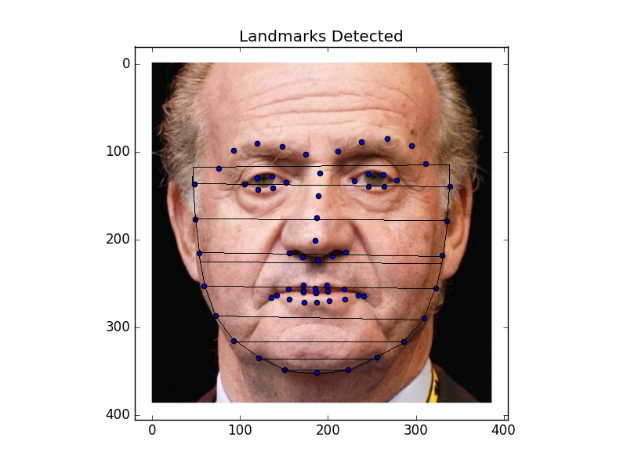
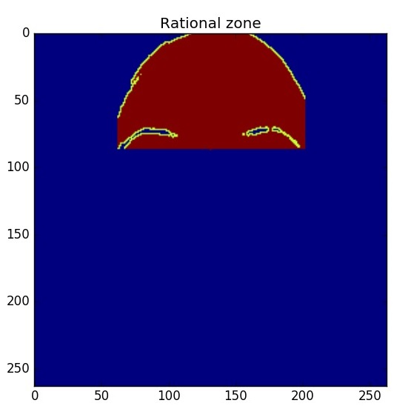
Rational: region growing
Emotional/Instinctive:
area aproximation by split

Slide 10
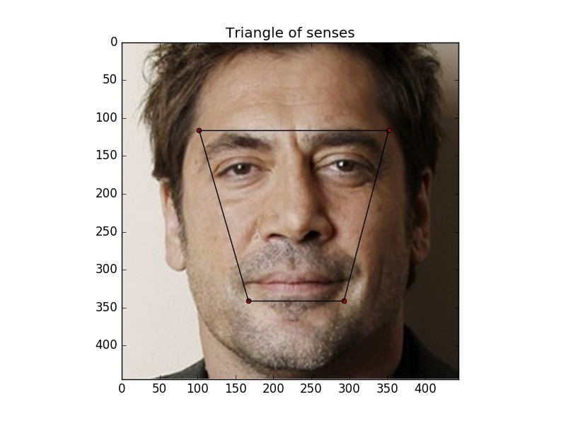
Triangle of senses analysis cryteria:
Expresses permeability, dispersion-concentration,…
Ratio=Little face area/Big face area obtained from landamarks.

Slide 11

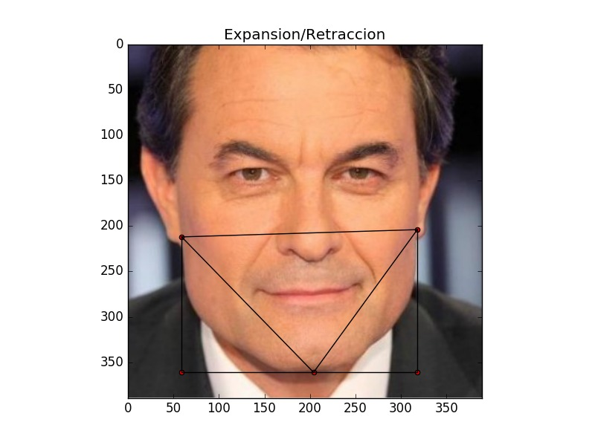
Expansion-Retraction analysis criteria
Expresses the energy level of a person, selectivity, selfpreservation, openness.

Slide 12
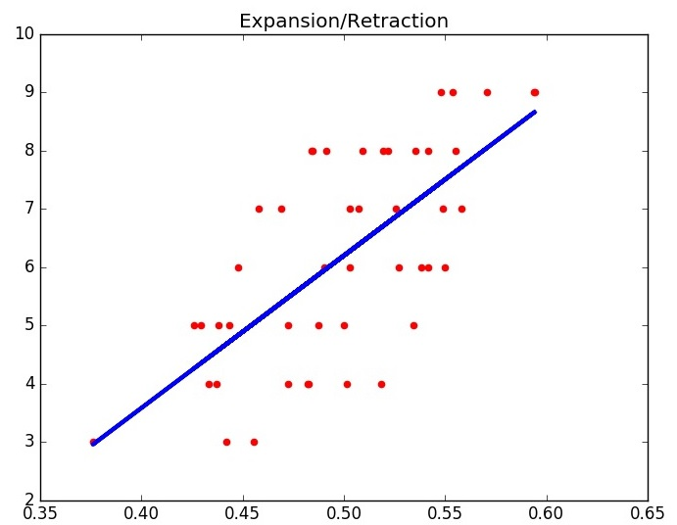
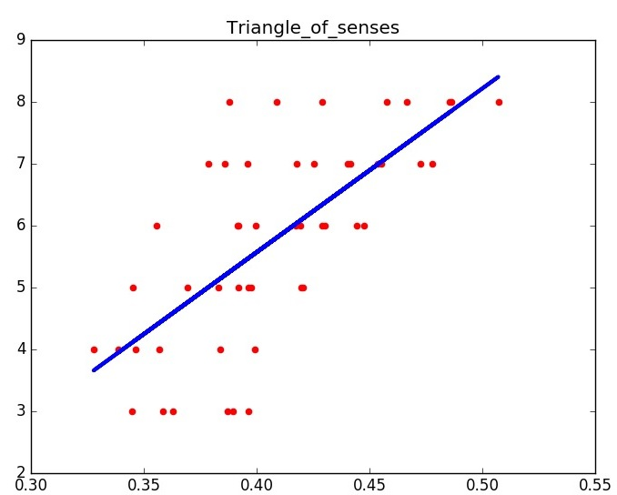
Linear modeling
Linear regressor trained with Leave-one-Out cross validation on predicted ratios vs ground truth set.
Average coeficient and intercept taken.

Slide 13
Discussion and Results
Expansion-Retraction error: 1.80910656857
Triangle of senses error: 1.44366166581
Three zones analysis: big discrepancies between predictions and ground truth, require still a lot of work to establish some coefﬁcients to model linearly our predictions and to reevaluate the ground truth.

Slide 14
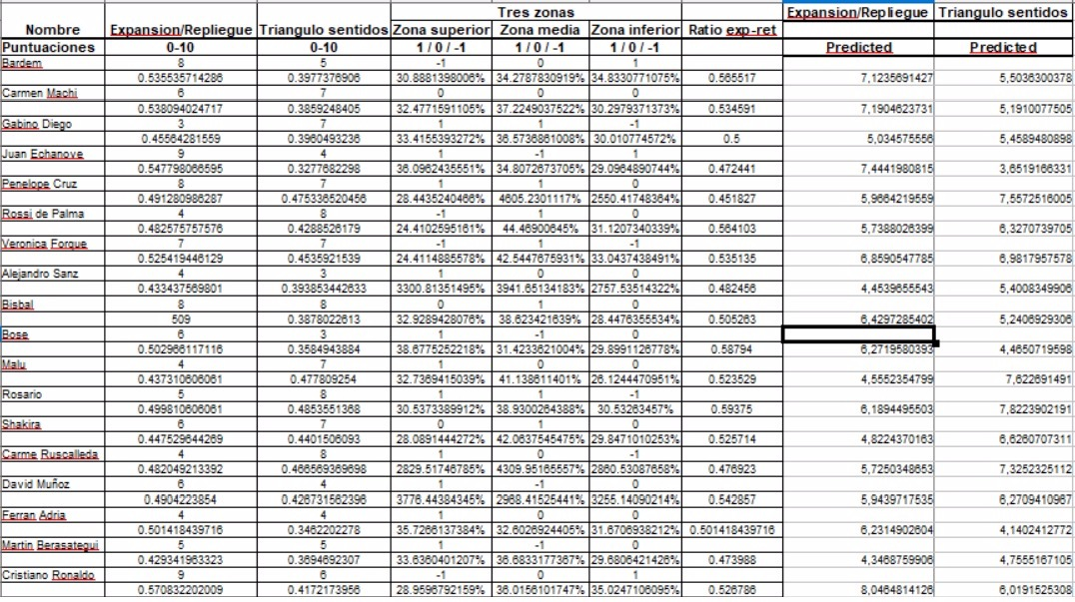
Results table

Slide 15
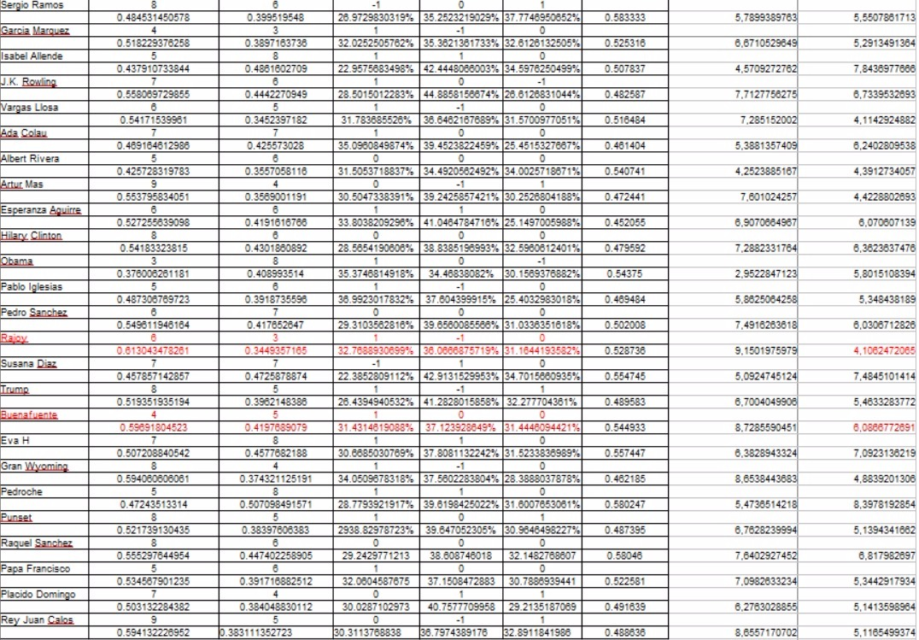

Slide 16
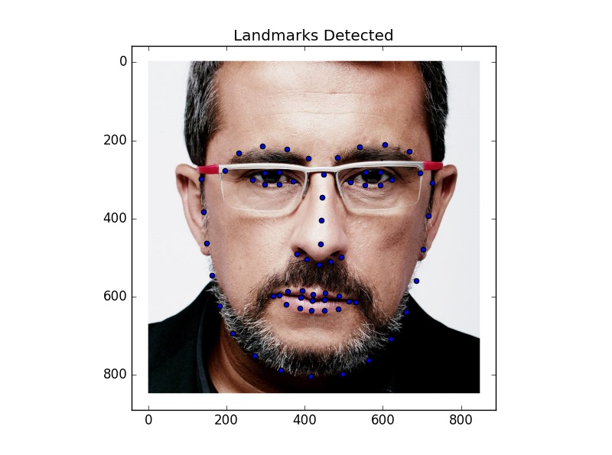
Sources of error
Ground truth error: first time defined and used value scale.
Image error: Postural diferences and ilumination noise.
Face alignemnt noise

Slide 17
Conclusions
First implementation of a system for analysing automatically three of the main criteria of morphopsychology, that give the most general overview of the personality of a person.
Acceptable error margin achieved for the ﬁrst approach in two of three cryteria.
Results show that there is a need to work closely with Sicograf-Institut Mellado to obtain more data and to redeﬁne some of the value scales.

Slide 18
Future work
Improve the results of the methods.
Create a new algorithm to ﬁnd landmarks with less noise and with forehead to later apply frontalization algorithm [9] for better images and discard the region growing for the forehead area.
Implement more psychomorphological analysis criteria .
Obtain much more data in order to be able to use NN to do a much more advanced approach to this matter.

Slide 19
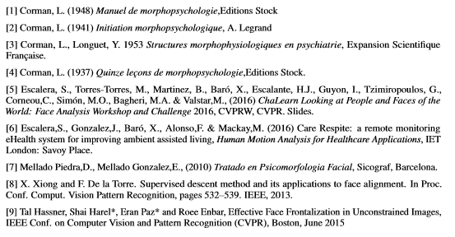
Bibliography

